Slide 1
AP Test Registration 2018

Slide 2
Why should I take the AP exam?
Earn College Credit - The amount of college credit awarded varies from college to college. Check the college websites for more information. Advanced college placement avoids repeating work and could save the cost of up to two years of study.
Gain Skills that will help You Succeed in College

Slide 3
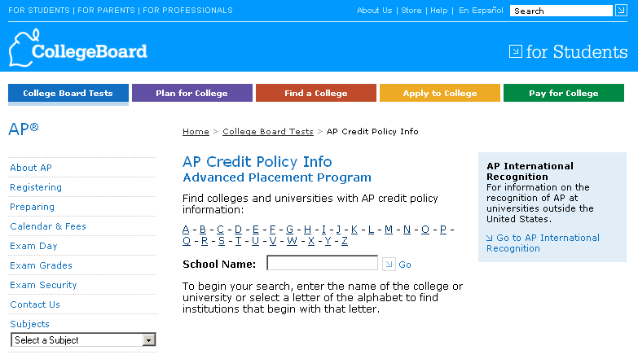
AP Credit Policy Information
Information about AP credit and placement policies at many colleges and universities is available at www.collegeboard.org/apcreditpolicy.
Search by college or university name or by letter of the alphabet
You will see two things for each school:
A link to the college’s own Web page that details its AP credit and placement policies.
A statement by the college or university about its AP policy.

Slide 4
AP Exam Schedule
Date | Morning (7:45am) | Afternoon (11:30am)
Monday, May 7, 2018 |  | Psychology
Tuesday, May 8, 2018 | Spanish Language
Wednesday, May 9, 2018 | English Literature
Thursday, May 10, 2018 | U.S. Government & Politics
Friday, May 11, 2018 | U.S. History | Studio Art
Tuesday, May 15, 2018 | Calculus AB | French Language
Wednesday, May 16, 2018 | English Language
Thursday, May 17, 2018 | World History
Cost per exam - $94/exam

Slide 5
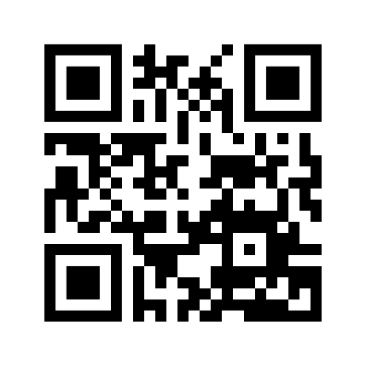
Registration Procedures
Free/Reduced Lunch Students
All exams are paid for by PGCPS
Must have at least a “C” average in the AP course
Register online via Google Form sent via email OR
Scan QR code:

Slide 6
Registration Procedures
Non-Free & Reduced Lunch Students
Must register online via Google Form sent via email OR scan QR code:
AND
Must pay online via My School Bucks at http://www1.pgcps.org/laurelhs/ OR http://laurelhscounseling.weebly.com/ OR scan QR code:
1 Exam = $94 2 Exams = $188 3 Exams = $282 4 Exams = $376

Slide 7
Frequently Asked Questions
Q: What if I don’t have a credit card or debit card to pay online?
A: Complete the paper registration form available in the counseling office and submit with money order to Mrs. Barnes. You still need to register with the Google form as well.
Q: What if I’m on Free/Reduced Lunch and don’t have a “C” average, but want to take an AP exam?
A: You are responsible for paying for your exam(s) and will have to pay for exams online via My School Bucks and register with the Google form as well.
Q: What if I’m absent on the day of the exam?
A: You will have to pay a $15 unused exam fee.
Q: What if I miss the deadline to register?
A: You will have to pay a $55 late fee in addition to the regular exam fee of $94.

Slide 8
What if I can’t take a test on the assigned day?
Reasons for which late testing will and will not be allowed are listed below. Only those students affected by the conflict may test late; all other students must test on the regularly scheduled date.
No Additional Fee Incurred | Additional Fee Incurred: $45 per exam
Conflict w/IB Exam | Academic contest/event
Conflict w/state mandated test | Athletic event/contest
Disabilities accommodations issue | Conflict w/non-AP or non-IB exam
Emergency: serious injury, illness, or family tragedy (Doctor’s note required) | Family/Personal commitment
Religious holiday/observances | Other school event
Three or more AP exams on same date
Two AP exams on same date and time
Notes:
Presenter can add to this information with the following points:
Advanced Placement® is a program developed and overseen by the College Board, the not-for-profit organization that is responsible for the PSAT/NMSQT®, SAT®, and other programs and services in college readiness and college success that help more than seven million students each year prepare for a successful transition to college.

Slide 9
Registration Deadline
March 20, 2018 (NO EXCEPTIONS)
Notes:
Presenter Notes:
Some of you may be familiar with our program and for many of you this will be new information. Our program continues to grow and evolve, so we hope you’ll find this information helpful.
This is your meeting so as we go through the information, please jot down your questions and I’ll stop periodically to answer them.

Slide 10
Notes:
Presenter Notes:
Some of you may be familiar with our program and for many of you this will be new information. Our program continues to grow and evolve, so we hope you’ll find this information helpful.
This is your meeting so as we go through the information, please jot down your questions and I’ll stop periodically to answer them.

